Slide 1
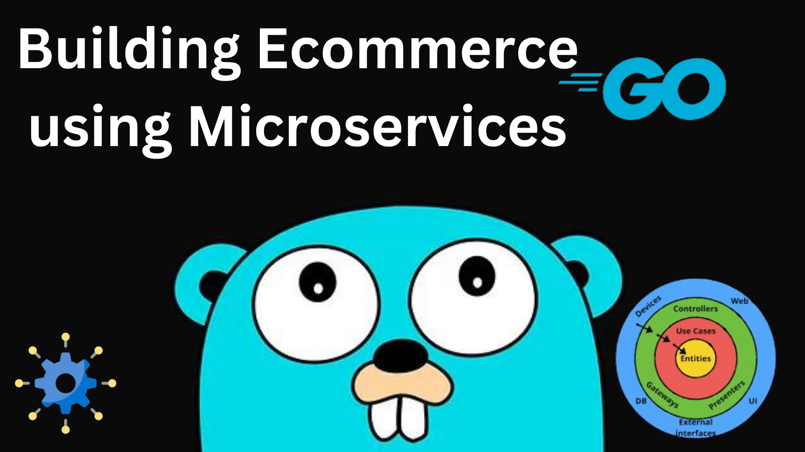
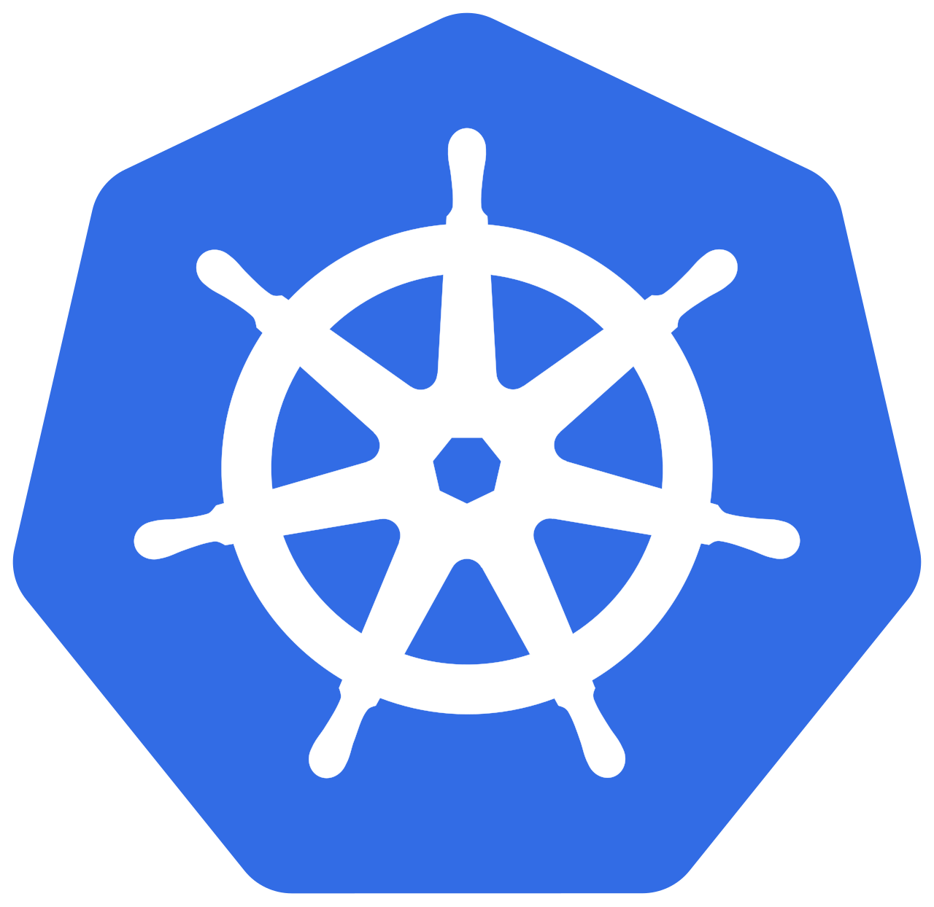

Slide 2
Index
Microservice Architecture
Core Services (User, Product, Order, Payment, Notification)
Implementing Microservices in Go
API Gateway: Concept and Role
Service Communication (REST/gRPC)
Service Communication Message Queues
Data Management per Service
Deployment (Docker & Kubernetes)
Monitoring and Security
Conclusion
Project Github Link

Slide 3
Microservice Architecture
The system consists of multiple backend services (User, Product, Order, Payment) accessed through a single entry point—the API Gateway. Clients (web/mobile) send requests to the gateway, which routes them to appropriate services. Supporting components include databases, service discovery, logging, and monitoring tools.

Slide 4
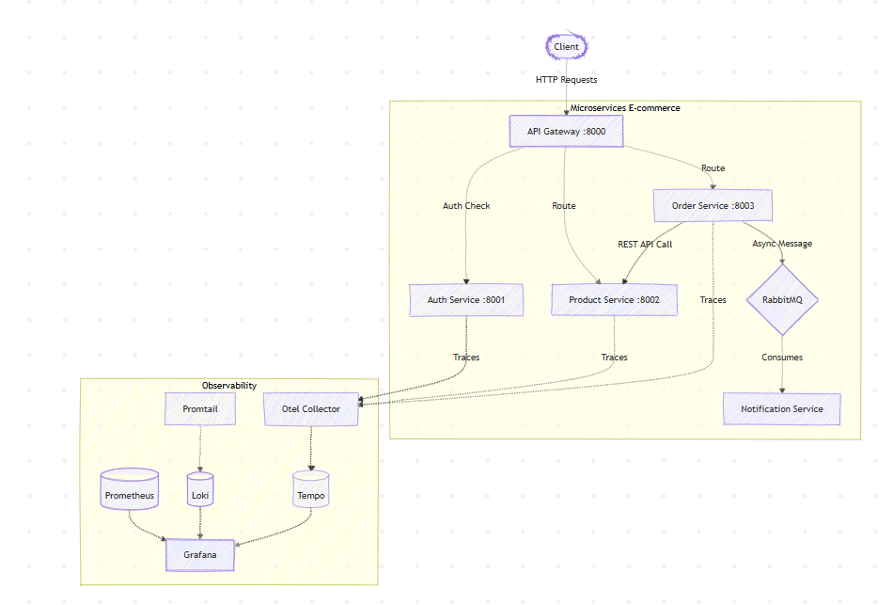
Overall Architecture

Slide 5
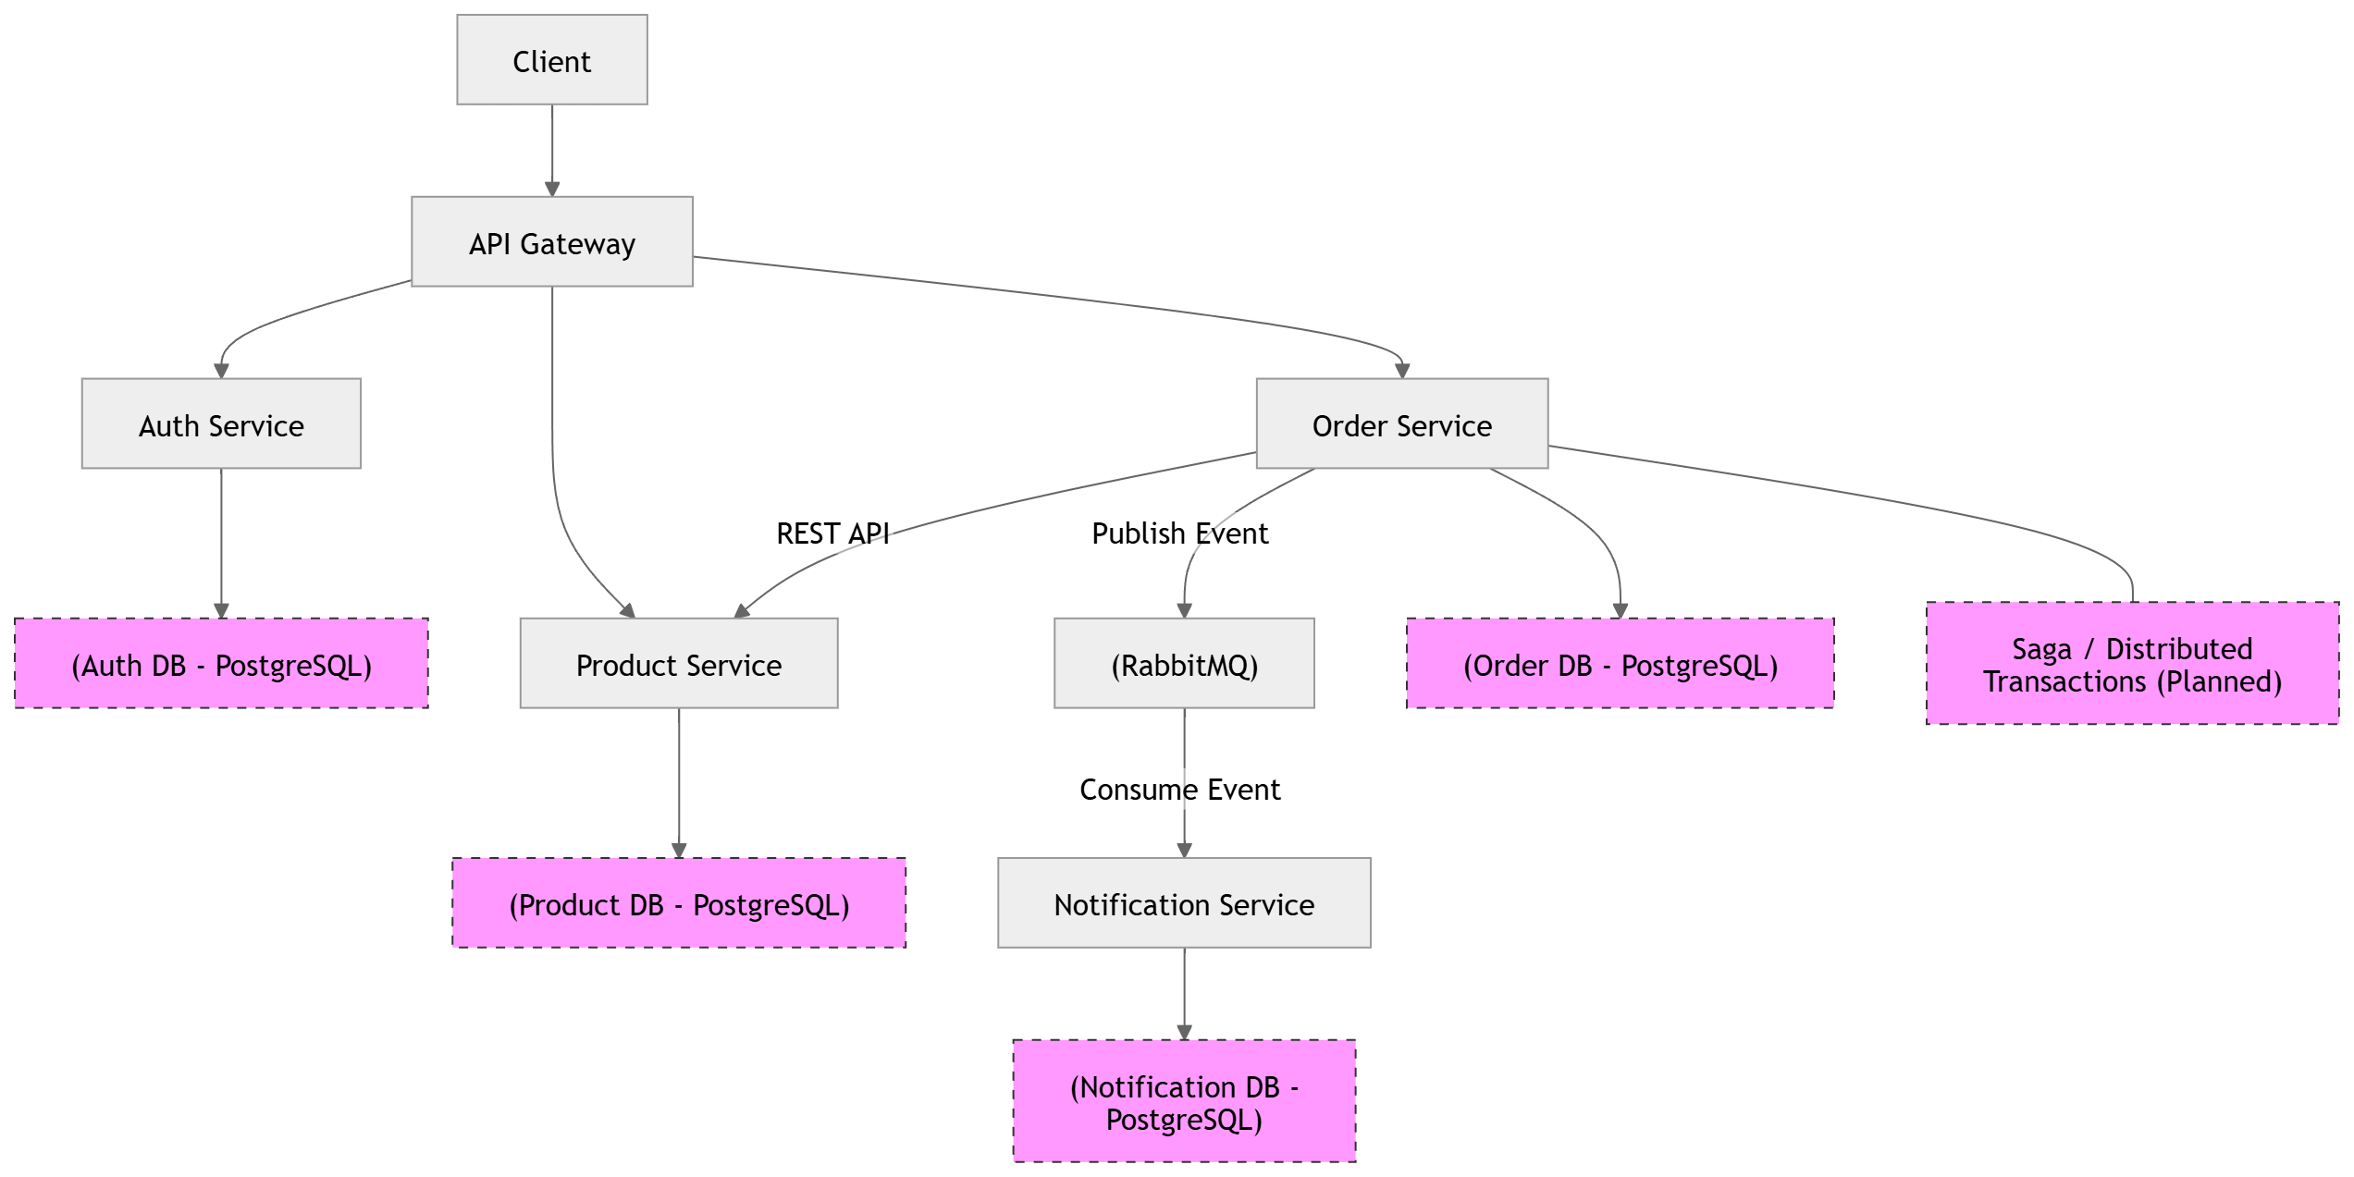
Microservice Architecture

Slide 6
Microservice Core Services (User, Product, Order, Notification)
Each service handles a specific domain:
User Service: authentication, profiles
Product Service: catalog, pricing
Order Service: order creation and tracking
Payment Service: transaction handling
This separation ensures clear responsibilities and independent scaling.

Slide 7
Implementing Microservices in Go
Go is suitable for microservices due to its performance, simplicity, and concurrency support (goroutines). Each service is typically built as a lightweight HTTP or gRPC server. standard net/http or chi are commonly used for building APIs.

Slide 8
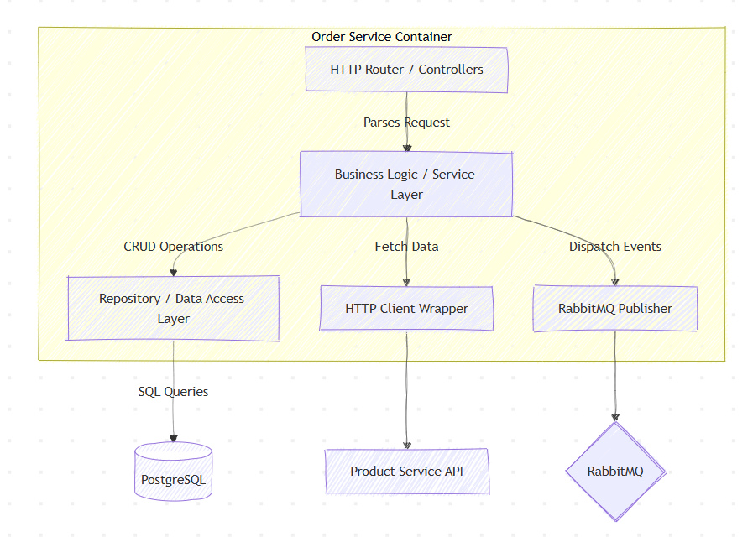
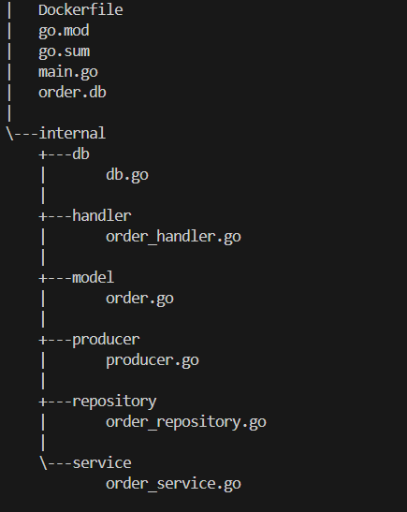

Slide 9
API Gateway: Concept and Role
The API Gateway acts as a central entry point for all client requests. It routes requests to appropriate services, aggregates responses, and handles cross-cutting concerns such as authentication, logging, and rate limiting. It simplifies client interaction with multiple services.
In Go, the API Gateway can be implemented using Go Chi. It handles request routing, validates tokens (JWT), and enforces authentication and authorization policies. Middleware is used for logging, security, and request filtering.

Slide 10
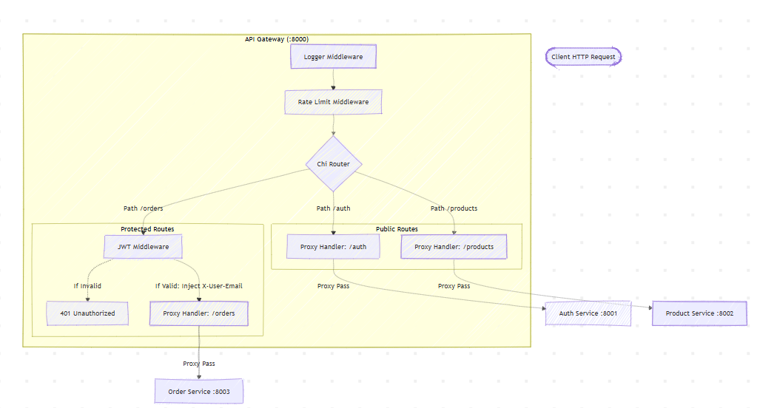

Slide 11
Service Communication (REST/gRPC)
Services communicate either via REST (HTTP/JSON) or gRPC (high-performance binary protocol). REST is simple and widely used, while gRPC offers better performance and strict contracts using Protocol Buffers. Choice depends on system requirements.

Slide 12

Service Communication Message Queues
for async communication between services queues are preferred as they form the backbone of event based system. there are 2 options in general as rabbitmq and kafka, rabbitmq worksa as a queue while in kafka all messages can be retrived and processed by next service serially as each service can get stream of all messages. it is good for high write and message backlogging, but expensive for smaller services. Here we are using rabbitmq between order and notification service.

Slide 13
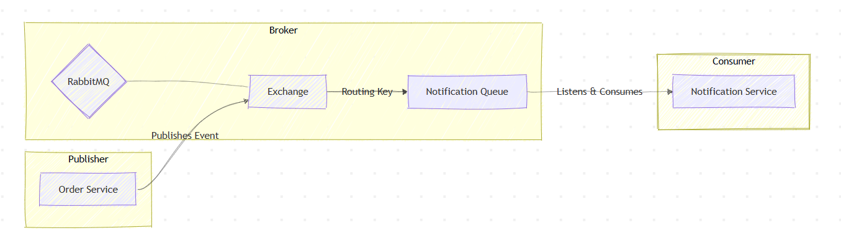
Service Communication Message Queues

Slide 14
Data Management per Service
Each microservice maintains its own database to ensure loose coupling. This avoids direct database sharing and allows independent schema evolution. Data consistency is handled using eventual consistency patterns and messaging systems. the database can postgres, mysql ,mongo or any other as per requirements

Slide 15
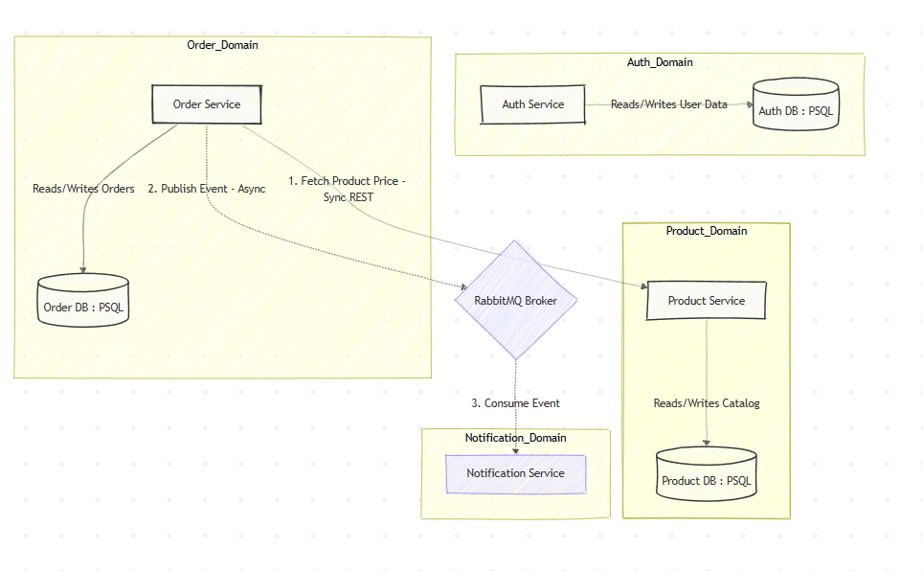
Data Management per Service

Slide 16
Deployment (Docker & Kubernetes)
Services are containerized using Docker to ensure consistency across environments. Kubernetes is used for orchestration, handling deployment, scaling, load balancing, and service discovery automatically. microservices are stateless so they can be scaled easily and for database dedicated services like rds or similar in other cloud are preferred
Simply use compose to convert docker compose to k8s manifests and update is as per requirements.
Command = kompose -f .\docker-compose.yml convert

Slide 17
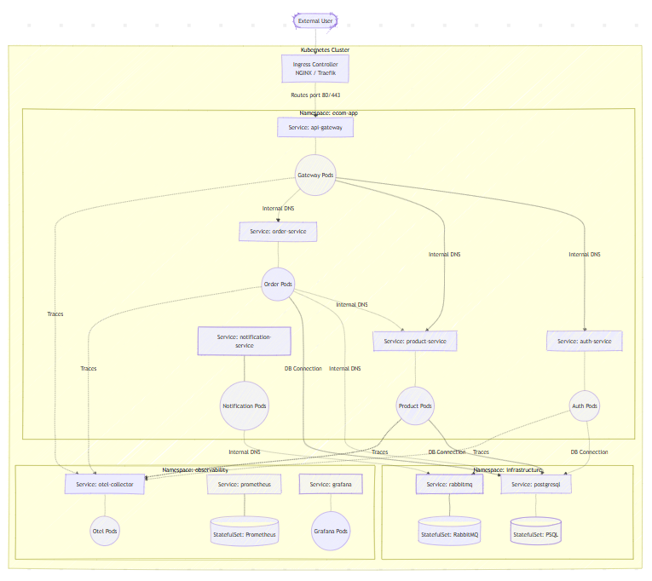
Deployment (Docker & Kubernetes)

Slide 18
Monitoring and Security
Monitoring tools track system health, logs, and performance metrics and tracing. Security includes authentication (JWT/OAuth), HTTPS communication, API rate limiting, and protection against attacks. Centralized logging helps in debugging.

Slide 19
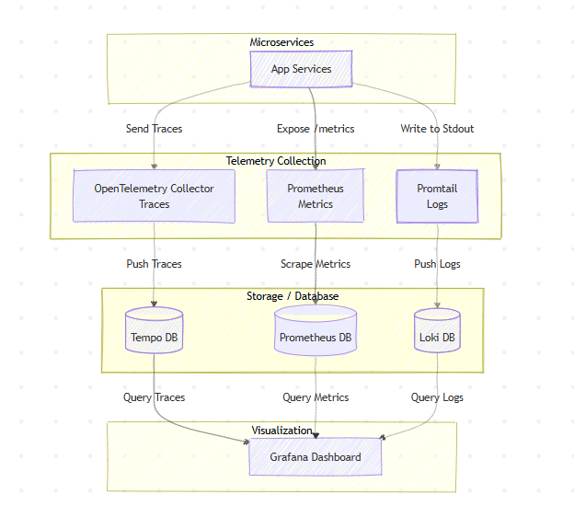
Monitoring and Security

Slide 20
Conclusion
Microservices with an API Gateway provide a scalable and flexible architecture for e-commerce systems. Go enables efficient service development, while tools like Docker and Kubernetes simplify deployment. Despite added complexity, this approach is well-suited for modern large-scale applications.

Slide 21
Project Github Link
https://github.com/subpxl/microservices-for-beginners

Slide 22


